Slide 1

CLASS : 1
SAS Tutorial
Presented By : Shashi Kumar

Slide 2
Syllabus :
Class No. | SAS Syllabus
1 | Introduction of SAS, Data Step, and Step Boundary
2 | SAS Library & related things Introduction of SAS Procedure with Proc print and Proc contents
3 | Backend process : PDV Filtrations : Slicing , Dicing , if , where, keep, drop
4 | Combining Data : Horizontal and Vertical merging
5 | Data Manipulation : SAS functions
6 | Data Importing : File ref, length statement, Datelines, cards, miss over, trun cover Descriptive Statistics : Proc freq, Proc means, Proc summary
7 | Formatting Data :Format , informant , label, attrib statements, length statement Creating Reports : Title, Footnotes, Option, ODS
8 | Summarization data: Retain, Sum statement Loops : do over loop & do, do while & do until loop

Slide 3
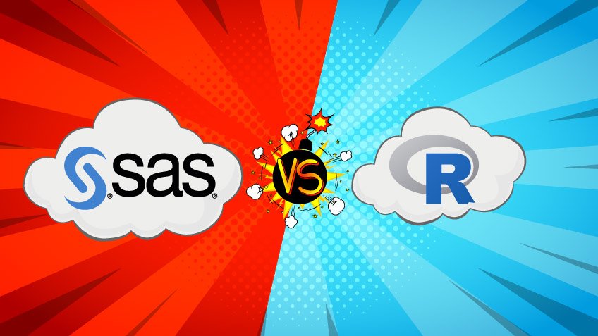


Slide 4
What is SAS & Why SAS ??
SAS ("Statistical Analysis System") is a software suite developed by SAS Institute for advanced analytics, multivariate analyses, business intelligence, data management, and predictive analytics.
Here is a brief description about the 3 ecosystems:
SAS: SAS has been the undisputed market leader in commercial analytics space. The software offers huge array of statistical functions, has good GUI (Enterprise Guide & Miner) for people to learn quickly and provides awesome technical support. However, it ends up being the most expensive option and currently being updated with latest trends like SAS Viya(R &Python).
R: R is the Open source counterpart of SAS, which has traditionally been used in academics and research. Because of its open source nature, latest techniques get released quickly. There is a lot of documentation available over the internet and it is a very cost-effective option.
Python: With origination as an open source scripting language, Python usage has grown over time. Today, it sports libraries (numpy, scipy and matplotlib) and functions for almost any statistical operation / model building you may want to do. Since introduction of pandas, it has become very strong in operations on structured data.

Slide 5
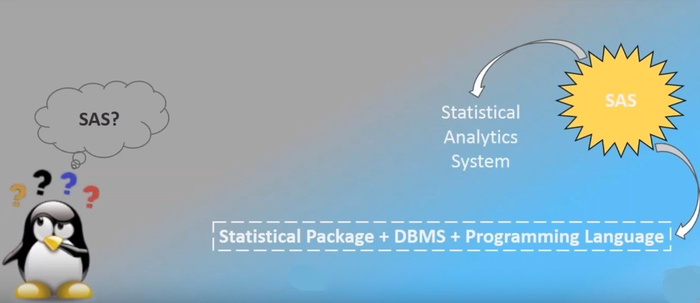

Slide 6
BASE SAS
Program
Advance SAS
SAS
Data Integration (DI)
Graphical User Interface (GUI)
Visual Analytics (VA)
Enterprise guide(EG)
Customer Intelligence (CI)

Slide 7







Foundation Of SAS
SAS :-
It is a highly flexible and integrated software environment that is used to access, manipulate, manage, analyze and report of data.
Access
Manage
Report
Analyze

Slide 8
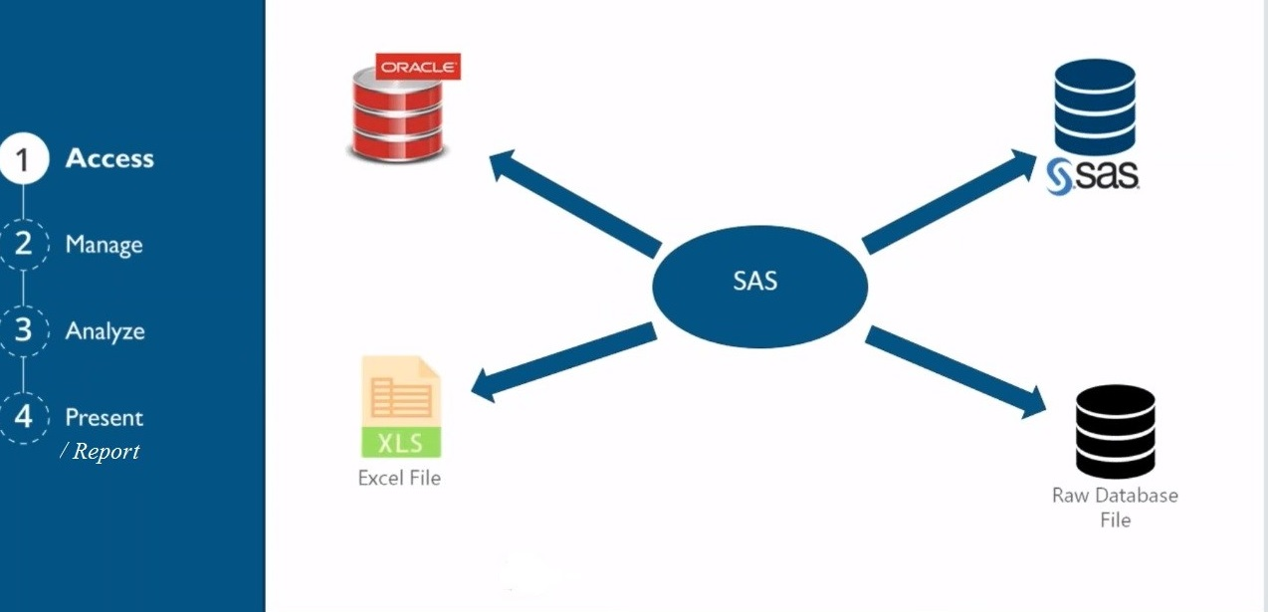

Slide 9
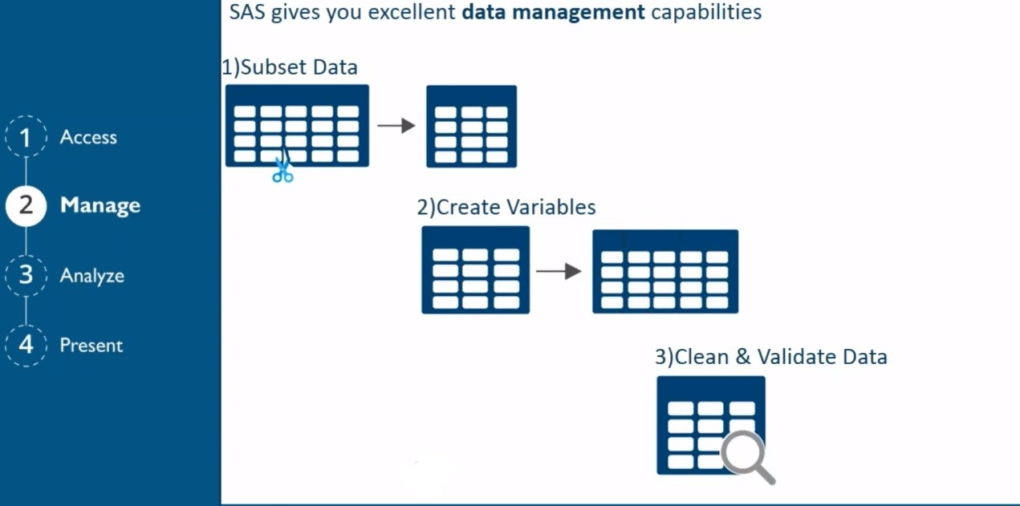

Slide 10
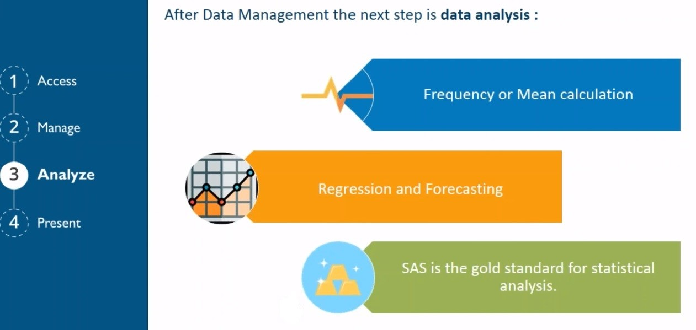

Slide 11
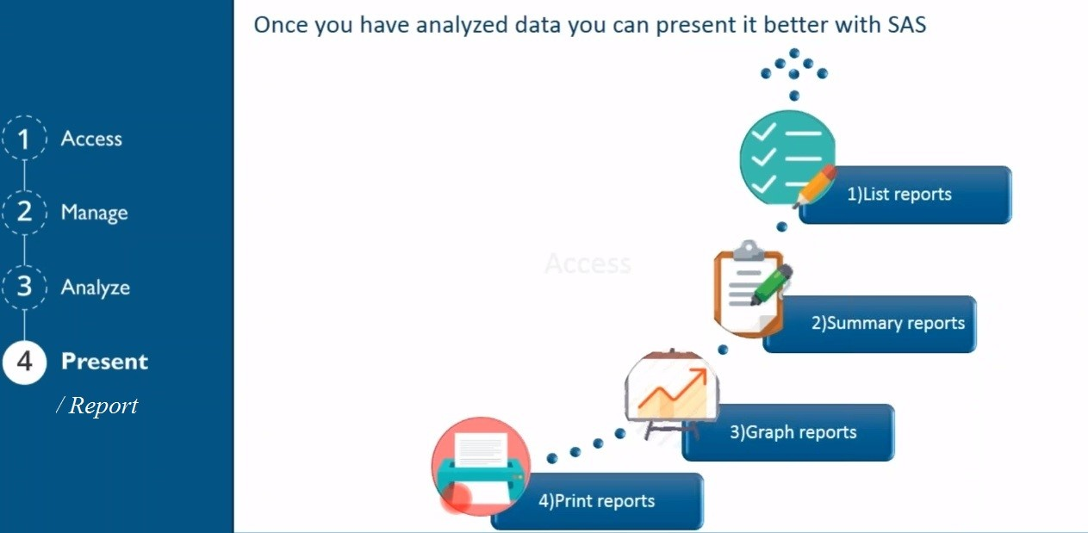

Slide 12
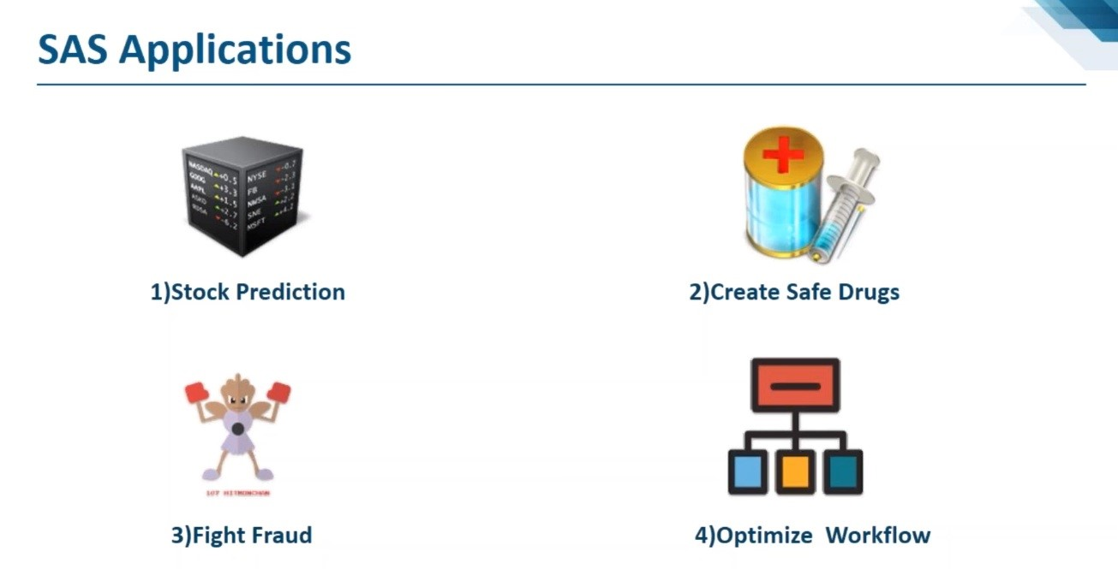

Slide 13
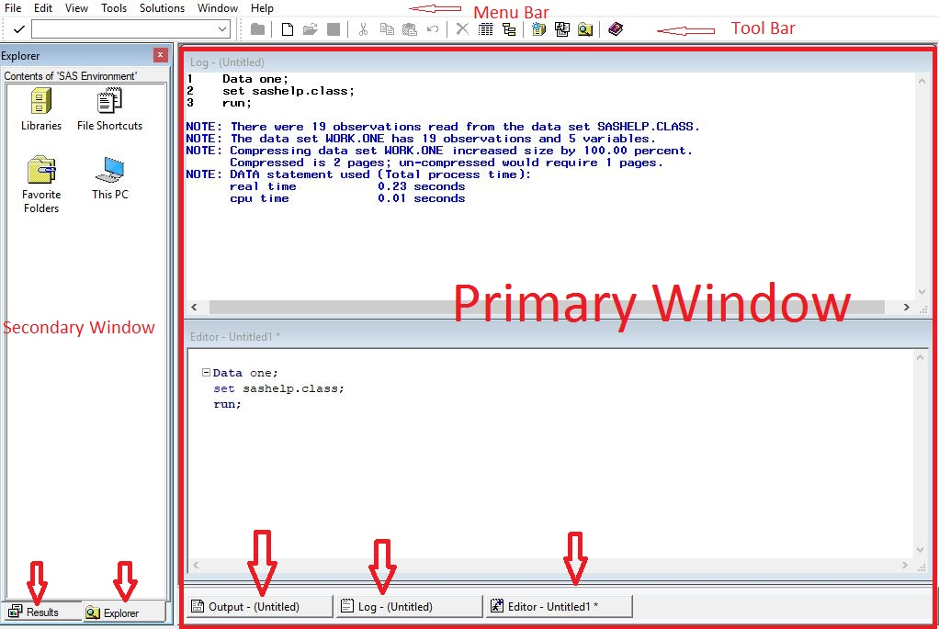
SAS Session

Slide 14
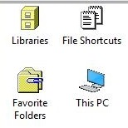
SAS Session
Primary Window
Outputs: Contain the report of procedure that have submitted and executed
Log: Provide Information about SAS program execution.
a. Note : Blue color
Numbers of observation
Data set names
b. Warning: Green Color
Execution Continue
c. Error: Red Color
Depend on error it will stop or continue the execution
3. Editor: The Place where SAS program is written, edited, submitted the program for execution.
Secondary Window
1. Result : It contains list of procedure which are submitted and executed successfully.
2. Explorer : Provide easy navigation to SAS library icon ,window system, my computer etc.

Slide 15
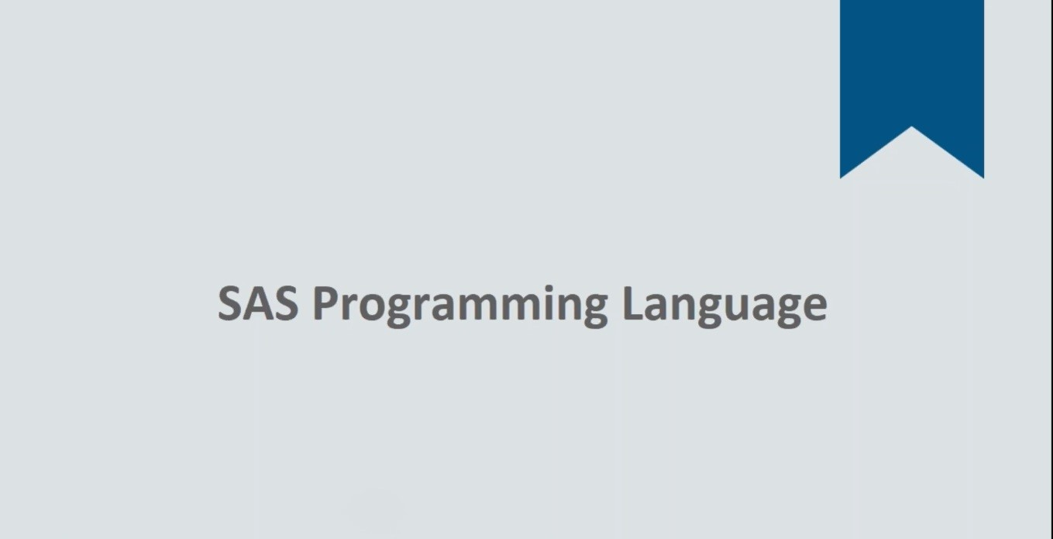

Slide 16
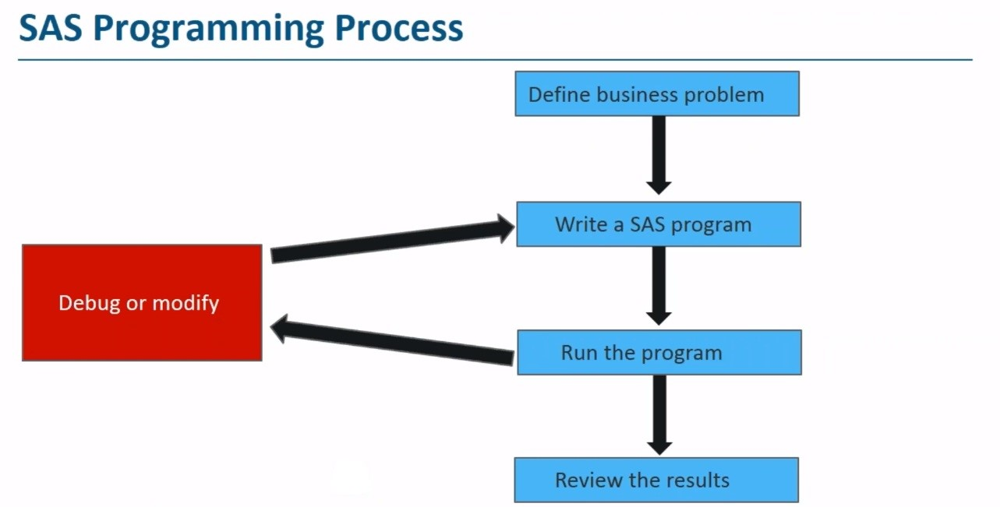

Slide 17
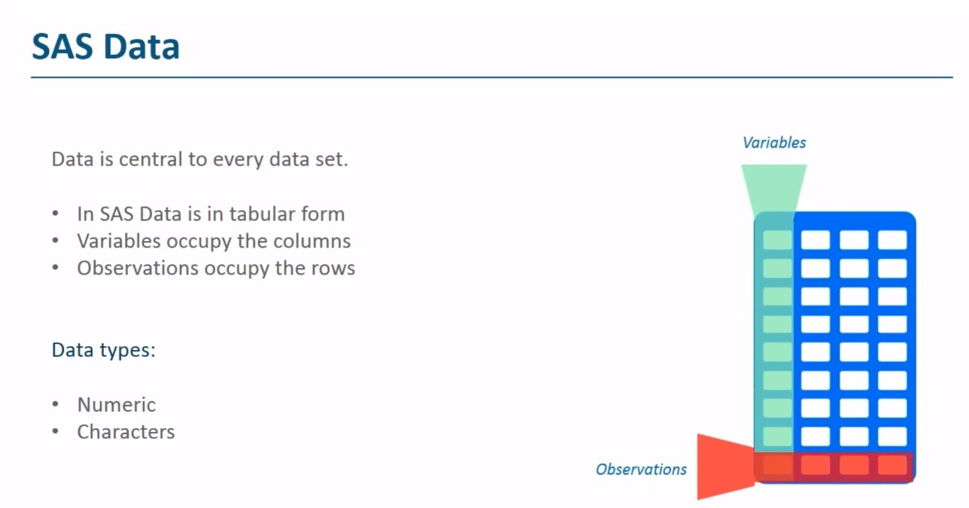

Slide 18
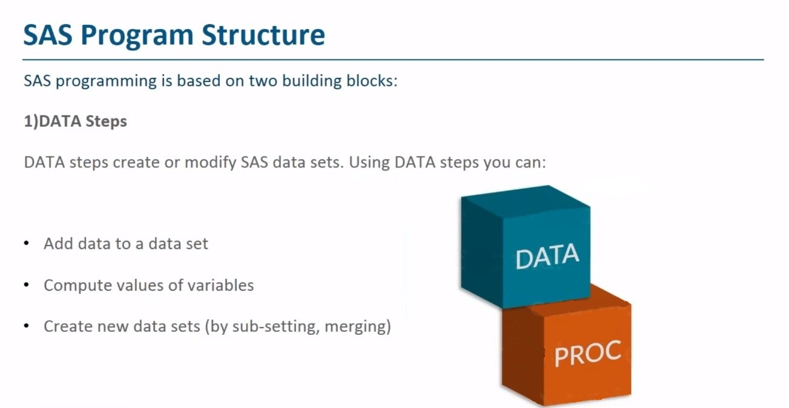

Slide 19
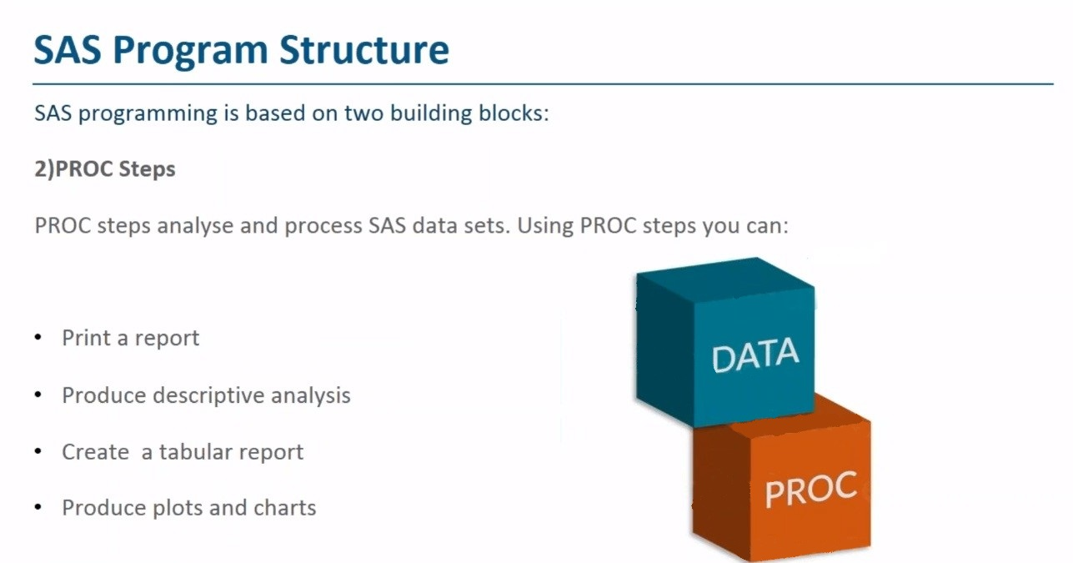

Slide 20
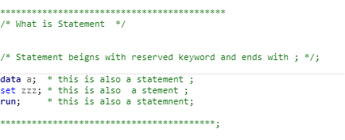
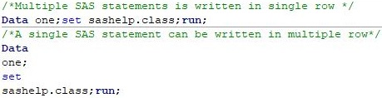
Topic: Data Step , Boundary, Statement
The DATA step consists of a group of SAS statements that begins with a DATA statement. The DATA statement
begins the process of building a SAS data set and names the data set. The statements that make up the DATA step
are compiled, and the syntax is checked.
SAS Statement : A SAS Statement begin with SAS identifying Keyword and end with semi column (;).
Properties:-
1.1 A Single SAS statement can be written in multiple row.
1.2 Multiple SAS statement is written in single row.
1.3 One or more blank separated the word.
Step Boundary : Program ends with SAS identifying Keywords e.g. run, quit and begin of new SAS program.
SAS Step : It is a combination of SAS statements ,the SAS step begin or start with identifying keyword i.e. data or proc and end
with step boundary.

Slide 21
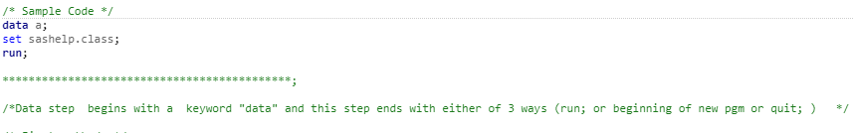
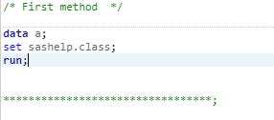
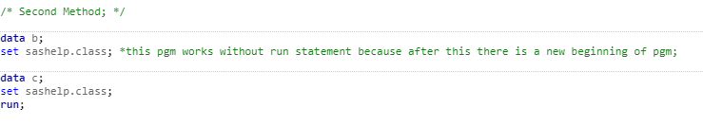
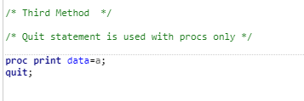
Topic: Data Step , Boundary, Statement

Slide 22
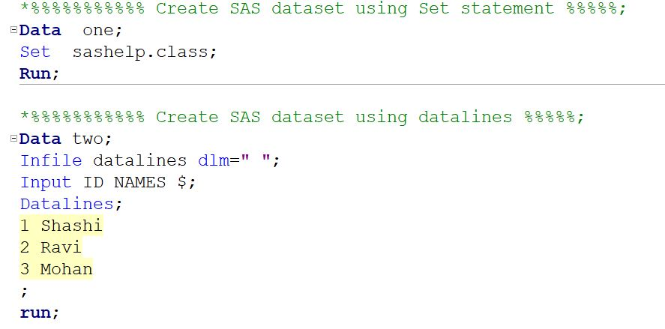
Exercise :

Slide 23
Thank You

